Slide 1



’’’
Practice coding with Code Clash!
’’’
while coding == True:
complete_tasks
practice_your_skills
compete_with_your_friends
Practice your skills
--> Improve your coding through practice
Compete with your friends
--> Code quickly to reach the
top of the leaderboard
Complete tasks
--> Try new timed coding challenge tasks

Slide 2
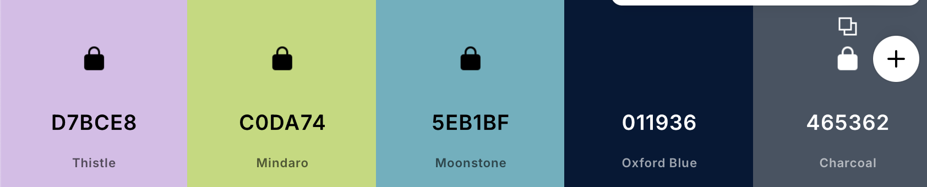
Colour scheme and logo
A68CE5
E88D58
216382

